Slide 1







PRESIDENCY UNIVERSITY, BENGALURU
Computer Organization & Architecture
Session 1: Course Orientation & Comprehensive Blueprint Introduction
45
5
4
Class Sessions
Course Outcomes
Core Modules

Slide 2
PRESIDENCY UNIVERSITY
Course Blueprint & Foundation
Bridging Digital Electronics with Modern Machine Intelligence, Hardware Security, and High-Performance Processor Systems.

Slide 3


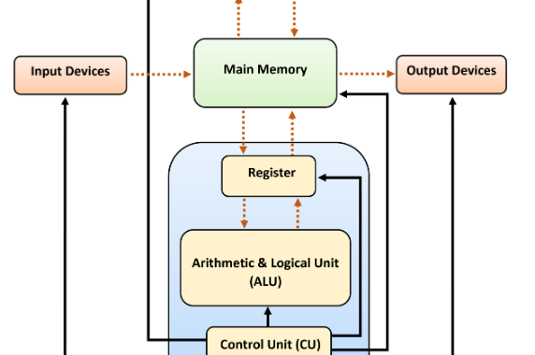
PRESIDENCY UNIVERSITY
Why Architecture Matters
Connecting Computer Architecture to Your Discipline:
•
Cyber Security (CCS): Understand hardware vulnerability vectors like Spectre, Meltdown, cache side-channels, and execution protection states.
•
AI & Data Science (CAI, CSD, CBD): Unlock GPU/TPU matrix acceleration, parallel pipelining, and memory bandwidth optimization.
•
Block Chain & DevOps (CBC, CDV, CIT): Master low-level register transfer operations, memory layout efficiency, and I/O bus throughput.

Slide 4







PRESIDENCY UNIVERSITY
Course Structure & Prerequisites
Prerequisite
Contact Hours
Classroom Tool
CSE2015 Digital Electronics: Fundamental knowledge of binary arithmetic, logic gates, flip-flops, multiplexers, and combinational circuits.
45 Total Sessions: 3 lecture hours per week (Credit structure 3-0-0-3). Regular attendance and LMS engagement mandatory.
Scientific Calculator: Essential for step-by-step arithmetic operations, Booth's multiplication, and floating-point computations.

Slide 5


PRESIDENCY UNIVERSITY
Course Outcomes (CO1 - CO5)
CO # | Course Outcome Statement | Bloom's Taxonomy
CO1 | Describe fundamental components of a computer system and their interconnections. | Understand [L2]
CO2 | Discuss concepts of Instruction Set Architecture (ISA) and memory organization. | Understand [L2]
CO3 | Apply techniques to perform arithmetic and logical operations in computer systems. | Apply [L3]
CO4 | Explain organization and functioning of processor and memory subsystems. | Understand [L2]
CO5 | Interpret security mechanisms and AI/ML techniques in enhancing system reliability. | Apply [L3]

Slide 6




PRESIDENCY UNIVERSITY
Course Delivery Roadmap
Module 1
Module 2
Module 3
Module 4
Basic Structures (12 Sessions) Functional Units, Bus Structures, RISC vs CISC, Performance Equation.
Arithmetic & I/O (10 Sessions) Booth Multiplier, Restoring Division, Interrupts, DMA Controllers.
BPU, Security & AI (11 Sessions) Control Sequences, Pipelining, Memory Security, AI Accelerators.
ISA & Memory (12 Sessions) Addressing Modes, Stacks, Subroutines, RAM/ROM, Cache Mapping.

Slide 7



PRESIDENCY UNIVERSITY
Syllabus Core Modules
Modules 1 & 2: Core Hardware & ISA
Modules 3 & 4: Computing Units & AI/Security
Focuses on fundamental computer components, bus communication, RISC vs CISC performance metrics, instruction formats, assembly level addressing modes, memory hierarchies, and multi-level cache mapping techniques.
Covers hardware multiplication and division algorithms, I/O handling via DMA and interrupts, CPU control unit sequencing, instruction pipelining, memory protection schemes, and AI accelerators (GPUs/TPUs).

Slide 8

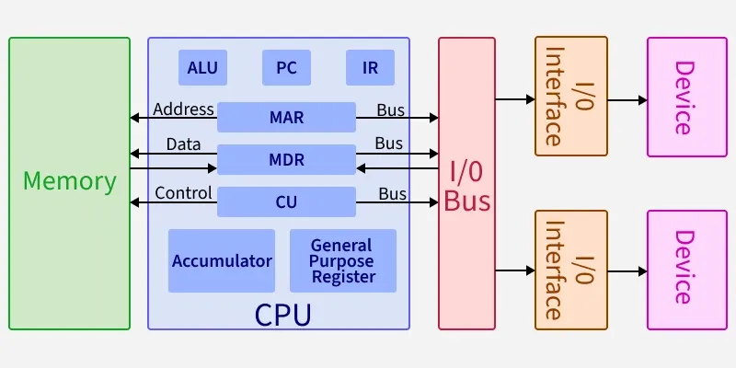
MODULE 1 DEEP DIVE
Basic Structure of Computers
12 Classroom Sessions (Target CO: CO1 [L2])
•
Functional Units: Input, Memory, ALU, Output, and Control Unit.
•
Bus Structures & Operation: Processor-memory communication and data transfer.
•
RISC vs CISC Architectures: Instruction set design philosophies.
•
Processor Performance Equation: $T = \frac{N \times S}{R}$, clock rate, and execution measurement.
•
Signed Numbers Arithmetic: Addition, subtraction, and memory instruction formats.

Slide 9

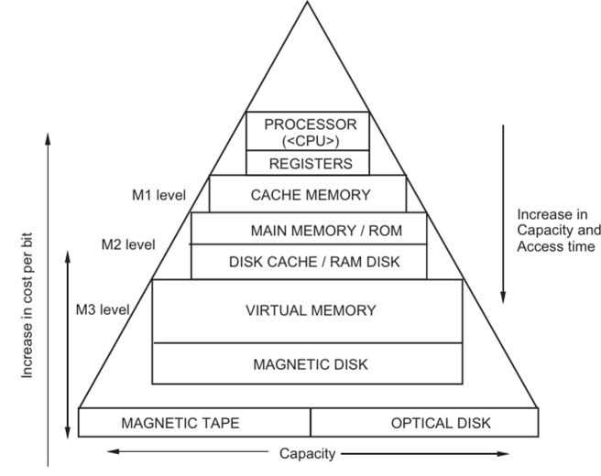
PRESIDENCY UNIVERSITY
Module 2: ISA & Memory System
12 Classroom Sessions (Target CO: CO2 [L2])
•
Instruction Set Architecture (ISA): Addressing modes (Direct, Indirect, Index, Relative, Auto-Increment).
•
Stacks & Subroutines: Stack frame management and nesting routines.
•
Main Memory Organization: Semiconductor RAM (SRAM/DRAM) & ROM chips.
•
Cache Memory System: Locality of reference, Direct Mapping, Associative, and Set-Associative mapping.

Slide 10
PRESIDENCY UNIVERSITY
Module 3: Arithmetic & I/O Design
Hardware Arithmetic
I/O Communication
DMA & Bus Protocols
10 Sessions (CO3 [L3]): Carry-Lookahead Adders, Booth's Signed Multiplication Algorithm, Restoring Division, IEEE Floating-Point arithmetic.
Program-Controlled I/O, Interrupt Hardware mechanisms, interrupt disabling/enabling, and priority handling across multiple peripheral devices.
Direct Memory Access (DMA) controllers, bus arbitration, synchronous vs asynchronous bus protocols, and parallel/serial interface circuits.

Slide 11

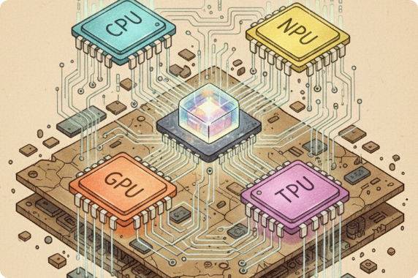
PRESIDENCY UNIVERSITY
Module 4: BPU, Security & AI
11 Classroom Sessions (Target CO: CO4 [L2] & CO5 [L3])
•
Basic Processing Unit: Control sequence, Single vs Multiple bus execution.
•
Pipelining & Hazards: Arithmetic & instruction pipelines, structural, data, and control hazards.
•
Hardware Security: CIA Triad, cache memory security protection, and side-channel mitigation.
•
AI Compute Architectures: Domain accelerators (GPUs, TPUs, NPUs) and ML workload scheduling.

Slide 12

PRESIDENCY UNIVERSITY
Continuous Assessment Scheme
Assessment Component | Syllabus Coverage | Duration | Marks | Weightage
Continuous Assessment 1 (Test) | Module 1 | 60 Mins | 15 Marks | 7.5%
Midterm Examination | Modules 1 & 2 | 90 Mins | 50 Marks | 25.0%
Continuous Assessment 2 (Test) | Module 3 | 60 Mins | 15 Marks | 7.5%
Continuous Assessment 3 (Quiz/Assign) | Module 4 | 60 Mins | 20 Marks | 10.0%
End Term Examination | Comprehensive (Modules 1-4) | 180 Mins | 100 Marks | 50.0%

Slide 13





PRESIDENCY UNIVERSITY
Textbooks & Special Pedagogies
Primary Textbooks
Special Pedagogies
1. Carl Hamacher et al., Computer Organization & Embedded Systems (6th Ed, McGraw-Hill). 2. William Stallings, Computer Organization & Architecture (11th Ed, Pearson).
• Collaborative Learning: Signed Arithmetic. • Flipped Classroom: Carry Lookahead Adders. • Blended Video Learning: Instruction Pipelining (NPTEL IIT Kharagpur/Madras).

Slide 14
PRESIDENCY UNIVERSITY
"The best way to predict the future is to invent it."
— Alan Kay, Turing Award Laureate
Welcome to CSS2257!
Questions & Open Discussion | Presidency Linways Portal Access

